Slide 1
Simulink Modeling Standard
Awareness Training
Julio M
Sr Controls Engineer – Continental AG
Notes:
Welcome! This is awareness training for the Simulink Modeling Standard. The goal is not to make you an expert, but to let you know there is help out there and where you can find it.

Slide 2
Title
  Introduction to Simulink Modeling Standard
Learning Objective
  The learner will gain an awareness of how to apply good practices on Simulink Modeling Standard to models used to generate production intent software.
Description
  This course is for engineers involved in developing Simulink models used in development for production intent software.
Notes:
Why refer to a Simulink Modeling Standard? Try to get some responses about why someone might want to look at Caterpillar’s Simulink Modeling Standard.

Slide 3
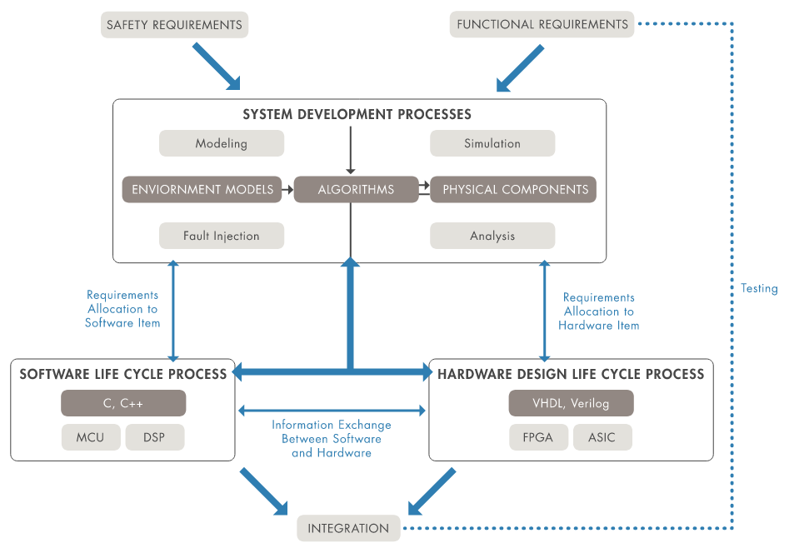
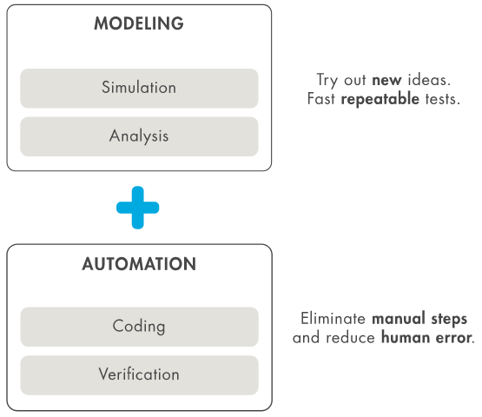
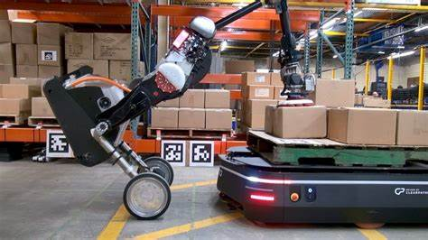







Notes:
Engineers use model-based systems engineering (MBSE) to manage system complexity, improve communication, and produce optimized systems. Successful MBSE requires the synthesis of stakeholder requirements into architecture models to create intuitive system descriptions.
Try new ideas and perform fast repeatable tests with modeling and simulation
Eliminate manual steps and reduce human error by automating key steps such as reporting, coding, and verification
Create a digital thread with traceability from requirements and system architecture to component design and tests
Perform predictive maintenance, detect faults, and optimize the system in operation using models as digital twins

Slide 4
Which would you prefer to change?
Notes:
The left- and right-hand side are exactly the same. Same behavior. Same generated code. Only the layout & text differs.

Slide 5
What Problems Exist?
Notes:
Problems with this subsystem:
Constant data is hard coded in the model rather than referenced from the base workspace
Rate Limiter Dynamic will not allow input to decrease when the input is an unsigned type
Selection block will not check the limits of the index before using it to access the data

Slide 6
Problems with this system
Constant data is hard coded in the model rather than referenced from the base workspace
  Rule 1: Model Code and Data Should be Separated
Rate Limiter Dynamic will not allow input to decrease when the input is an unsigned type
  Rule 2: Prohibit Unsigned Integer Signal Passed to Rate Limiter Dynamic
Selection block will not check the limits of the index before using it to access the data
  Rule 3: Indexing

Slide 7

Before to move to boring rules…
Let’s step back to some non-written rules (good practices)

Slide 8
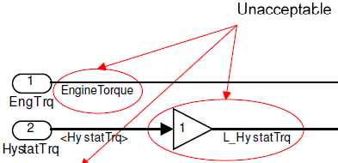

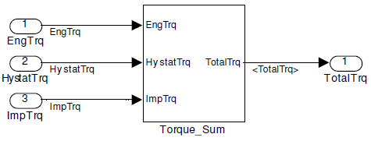
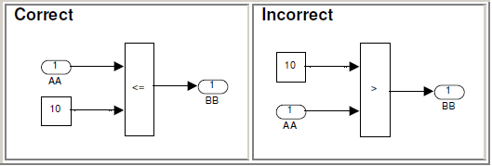
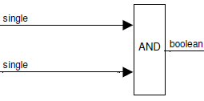
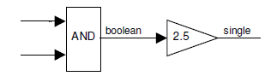
What should a model look like?
There are a lot of general rules to follow, but here is a quick list:
  All block names and signal names must be below the block or line
    Only exception is feedback systems where labels will be above the signal line
  Port names must be visible and only include the port number in the block
  Signal names should use the same abbreviations as the input/output ports
    The “<“ “>” signs show that the name is inherited from elsewhere and is acceptable
  Leave enough space between blocks for signal names to be readable
  Avoid using blocks just to change the signal name (like a gain of “1” block)
  Relational operator independent variable must be the first port
  Avoid mixing logical and numerical operations

Slide 9
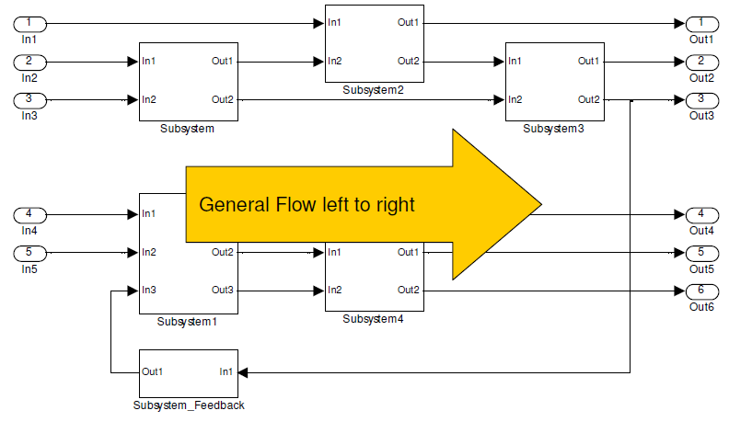
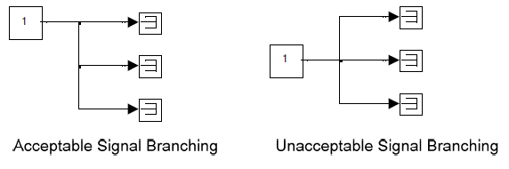
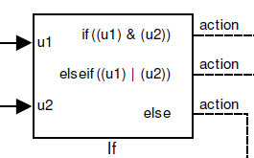
What should a model look like?
There are a lot of general rules to follow, but here is a quick list (cont’d):
  Systems should flow from left to right
  Feedback subsystems and unit delay blocks should flow right to left
  Signal lines should be routed to minimize crossing
  Subsystems should be organized to minimize signal line crossing
  Signal line branches should not split in more than 2 directions
  Always have a default (else) case for switches and if statements (no multi-switches)
There are exceptions, but they should be carefully considered

Slide 10

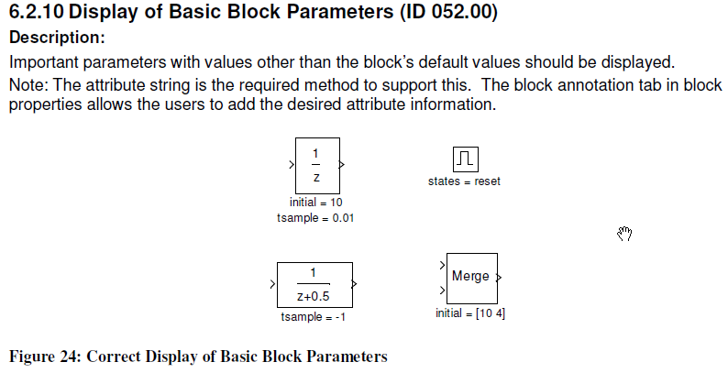
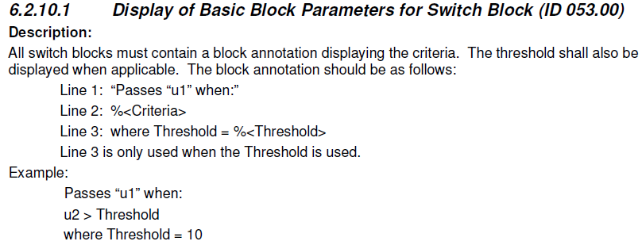
What is block Annotation?
  We should use annotations and typically hide the default names of the blocks
  The name of the block must be descriptive to bother showing it
This applies to:
  Gain blocks that are too small for the full gain value/name to display (%<Gain>)
  Map blocks (%<mapName>)
  Switch blocks (see next slide)
  Any other block with hidden configurations, like sample time or initial conditions
Use “Annotation” vice changing names of blocks

Slide 11
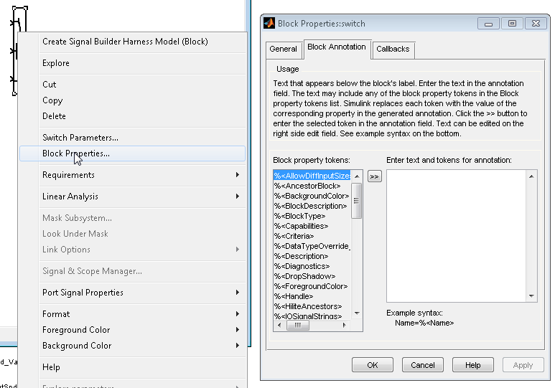
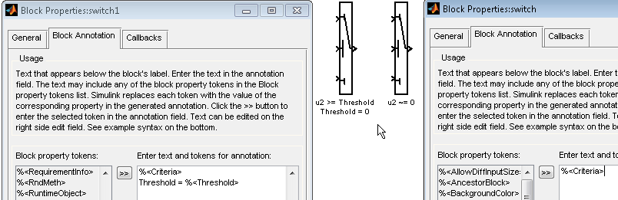
How do I add Annotation?
Right-click on the block to get to Block Properties

Slide 12
Back to the MUST rules
Which Simulink models must conform to the Standard?
In Scope
Out of Scope
Simulink model used to generate C code which runs on an ECM for production
Simulink model used to generate a flash file directly for production
Simulink model used to be integrated in upper SW layer
Desktop simulations
Models used as a test harness (MIL/HIL)
Models used to generate a flash file used in rapid prototyping
Models on a development branch not ready to merge

Slide 13
Model Architecture
Model Layers:
Code Gen Model Top Level Simulink Subsystem
Description:
The root code generation model shall contain only one subsystem with control content. Device drivers shall be located in independent input and output subsystems. Application content that is not control, input, or output may be grouped into appropriate subsystems. The subsystem should be a library link if test or rapid prototyping tools reference the same content.

Slide 14
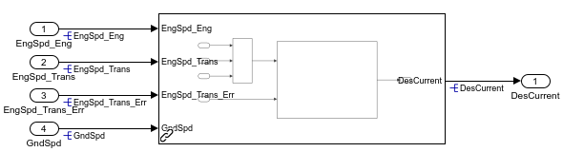
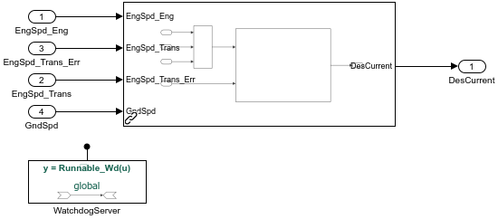
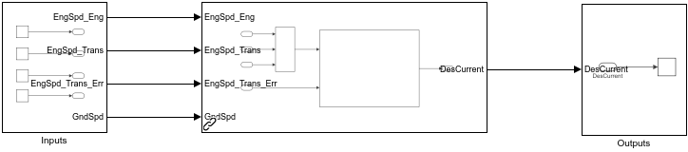
Appropriate Package Architecture Model
Appropriate AUTOSAR Model
Appropriate Direct to Flash Model

Slide 15
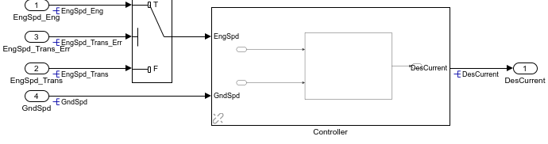
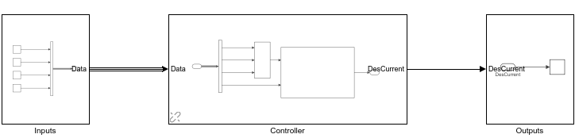
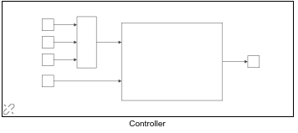
Inappropriate calculation in model root
Inappropriate use of bus in model root
Inappropriate packaging of interfaces into controller

Slide 16
Model Layers:
Additional Allowed Blocks at Model Top Level
Description:
The interface blocks, model configuration blocks, and data type convert blocks may also be included in the root code generation model.

Slide 17
Model Layers:
No Calculations at Model Top Level and Feature Integration Level
Description:
There shall be no calculations at the top level and feature integration level of the model. All calculations shall be fully contained within a reusable feature library model or a subsystem.

Slide 18
Model Layers:
Signals at Feature Integration Level
Description:
All signals at feature integration level of the model shall be contained in a signal bus. This simplifies routing between the reusable feature library models. Prior to each reusable feature library model a bus selector block shall be used to select the signals required as inputs to the reusable feature library models.
A bus creator shall be used immediately outside of the reusable feature library models to group all the output signals from the reusable feature library models into a bus. All buses shall be named. The bus’s name shall reflect the reusable feature library models from which the signals originated. The bus name shall be displayed below the bus immediately after the bus creator block and shall also be displayed at each bus selector block used in the model. No goto/from blocks are allowed at the feature integration level.

Slide 19
Documentation Standards
Simulink, state flow and embedded code:
Comments
Description:
Comments within the model are to be used as needed to explain the model and how it works. Comments of this type are similar to the comments required in handcode. They should not re-state the obvious model functionality, but provide insight into why the model is designed the way it is and how the model’s implementation relates back to meeting the requirements.

Slide 20
Simulink, state flow and embedded code:
Display of Text Annotations
Description:
All text annotations shall be formatted so that they are easily distinguished from other text. The choice should be standardized by the group’s styleguide to ensure consistency within and across models.

